Slide 1
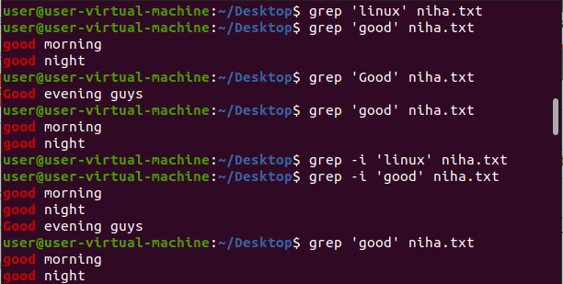
GREP COMMANDS
-c : This prints only a count of the lines that match a pattern -h : Display the matched lines, but do not display the filenames. -i : Ignores, case for matching

Slide 2
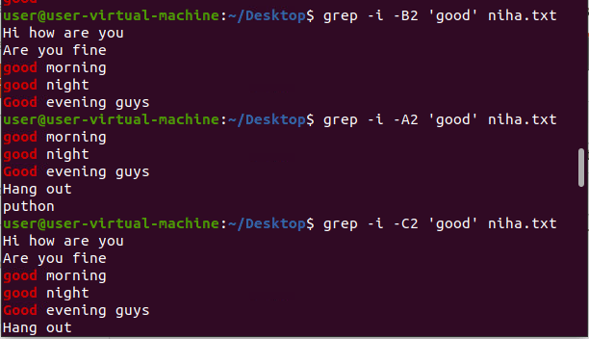
-A n : Prints searched line and nlines after the result. -B n : Prints searched line and n line before the result. -C n : Prints searched line and n lines after before the result.

Slide 3
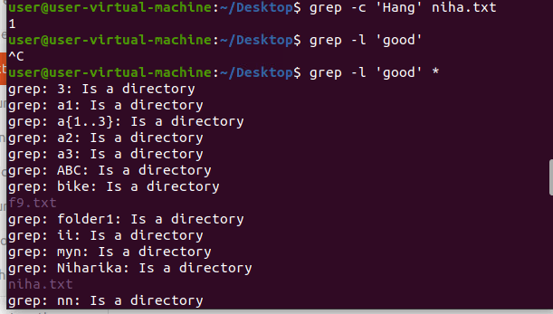
-l : Displays list of a filenames only. -c : This prints only a count of the lines that match a pattern

Slide 4
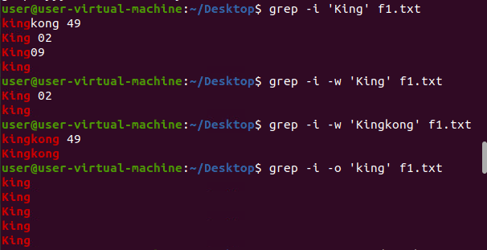
-w : Match whole word -o : Print only the matched parts of a matching line, with each such part on a separate output line.

Slide 5
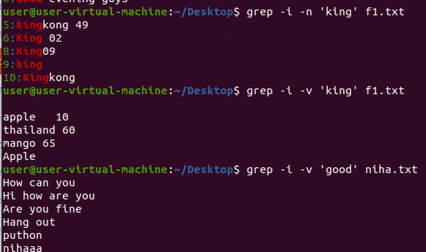
-n : Display the matched lines and their line numbers. -v : This prints out all the lines that do not matches the pattern

Slide 6
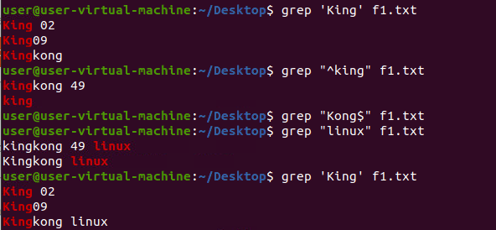
-e exp : Specifies expression with this option. Can use multiple times. -f file : Takes patterns from file, one per line. -E : Treats pattern as an extended regular expression (ERE)

Slide 7
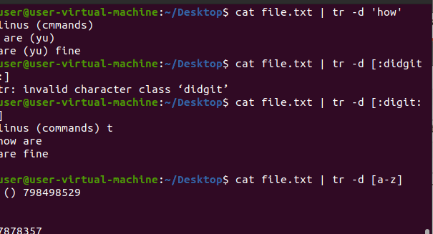
-d : delete characters in the first set from the output. tr –d :flag to delete characters, for example to remove the spaces in the domain names using the following command. tr [a-z] [A-Z]:command to change all lower case letters to upper case in a file as shown.

Slide 8
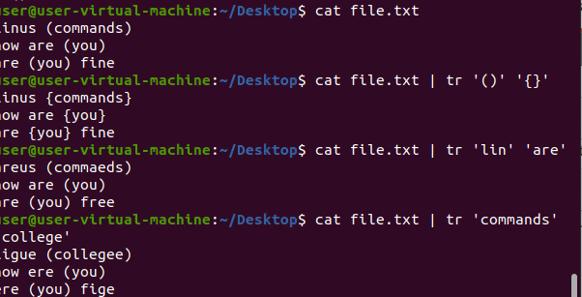
-c : complements the set of characters in string.i.e., operations apply to characters not in the given set tr '{}' '()' < inputfile > outputfile: we will translate braces in a file with parenthesis. $ echo "This is for testing" | tr [:space:] '\t':command will translate all the white-space to tabs

Slide 9

echo "my username is 432234" | tr -cd [:digit:]:to remove all characters except digits.

